Slide 1
G C2
i
Team Members
Arun Kumar
Mayank Singh
Abhishek Tiwari
Vishal Sahu

Slide 2



Medes App
i
We are always ready to help you

Slide 3

Why we need this application?
To Provide fast Delivery
To find medicine available in pharmacies
nearby
To save your Time and Money

Slide 4
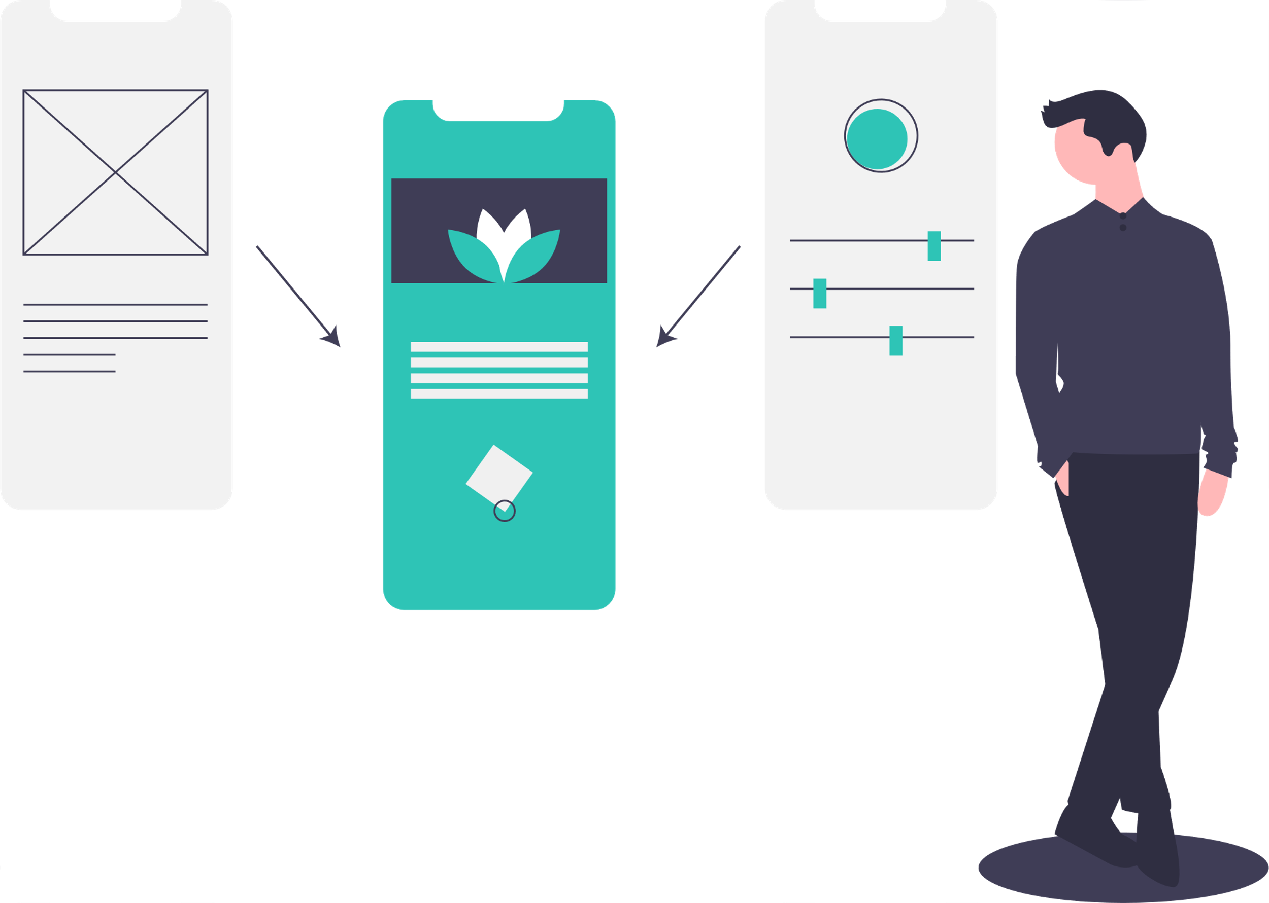
Simple UI
i

Slide 5

i
Import
From Nearby Shops

Slide 6

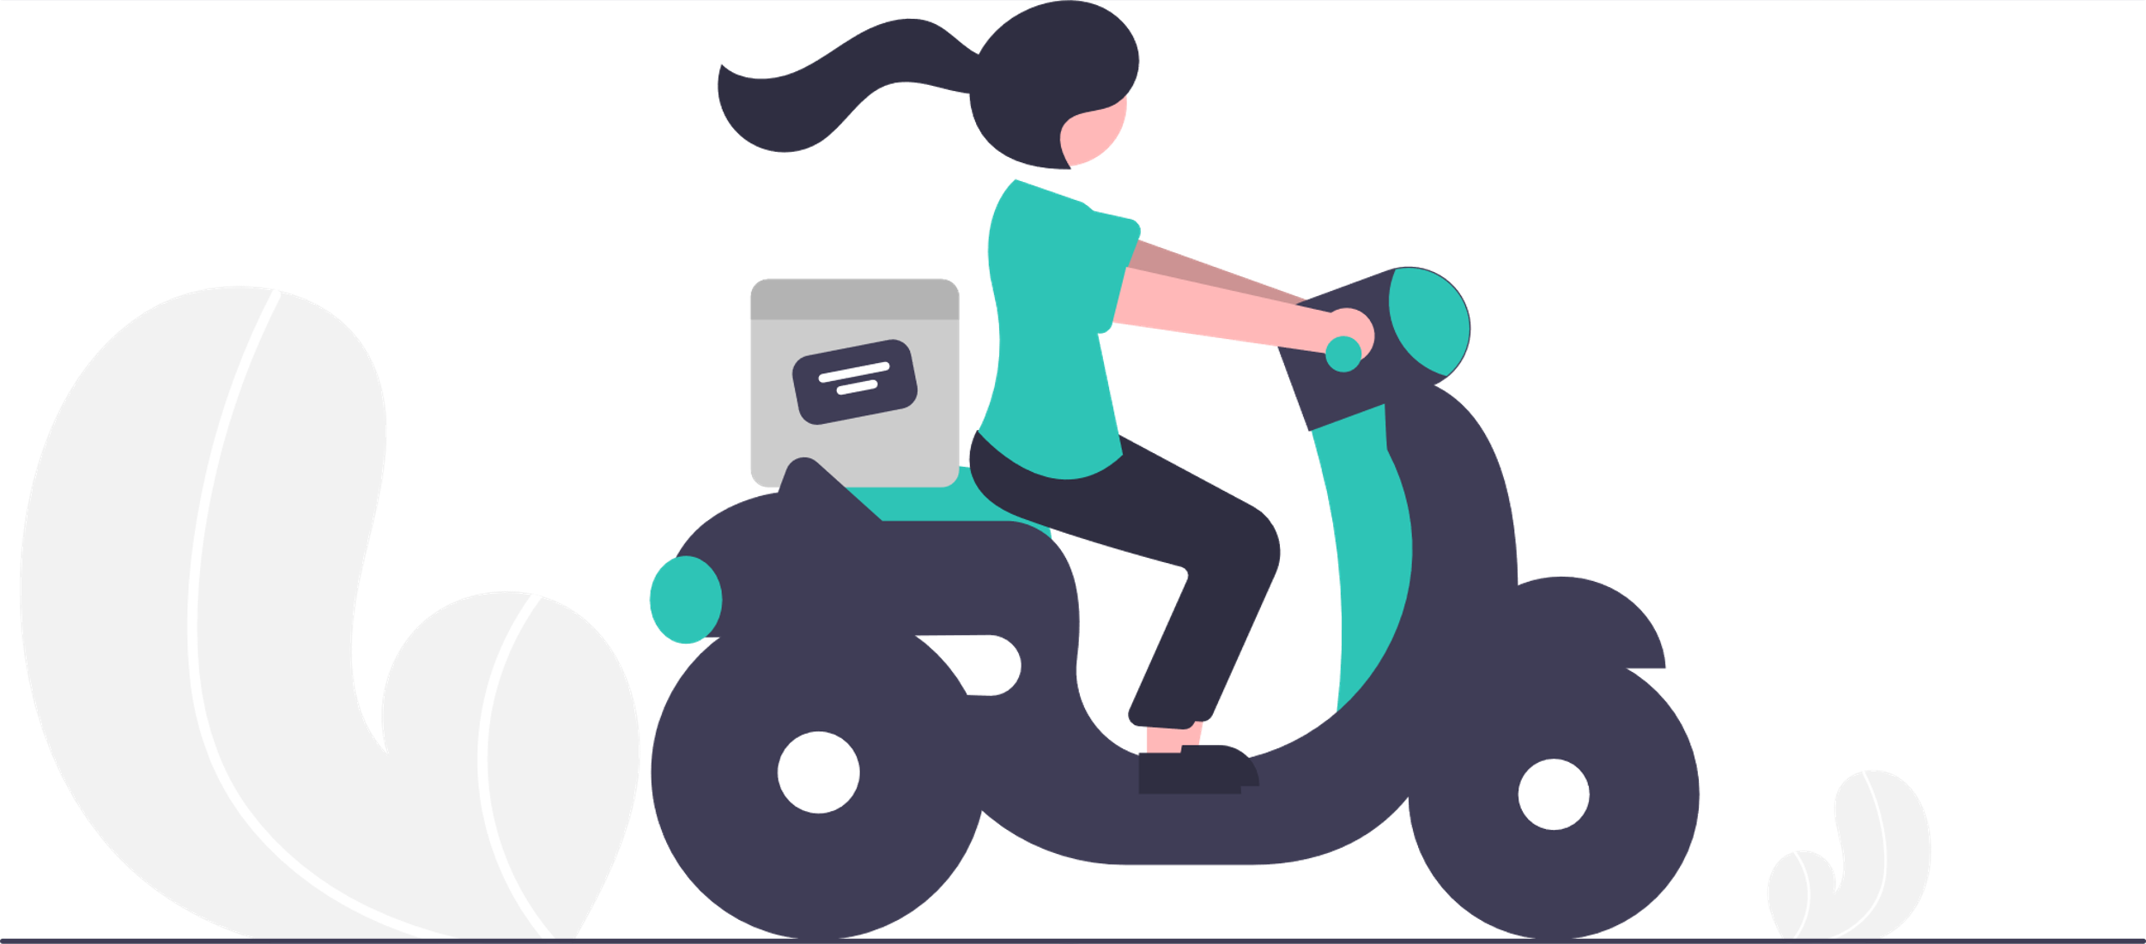
Deliver Within
i
30min

Slide 7
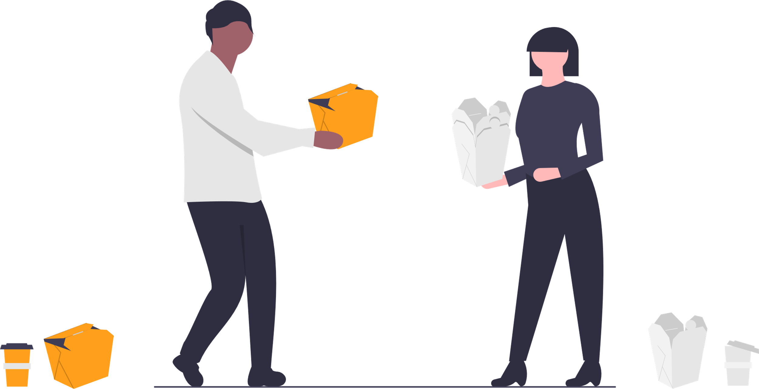
i
Late Night Delivery

Slide 8
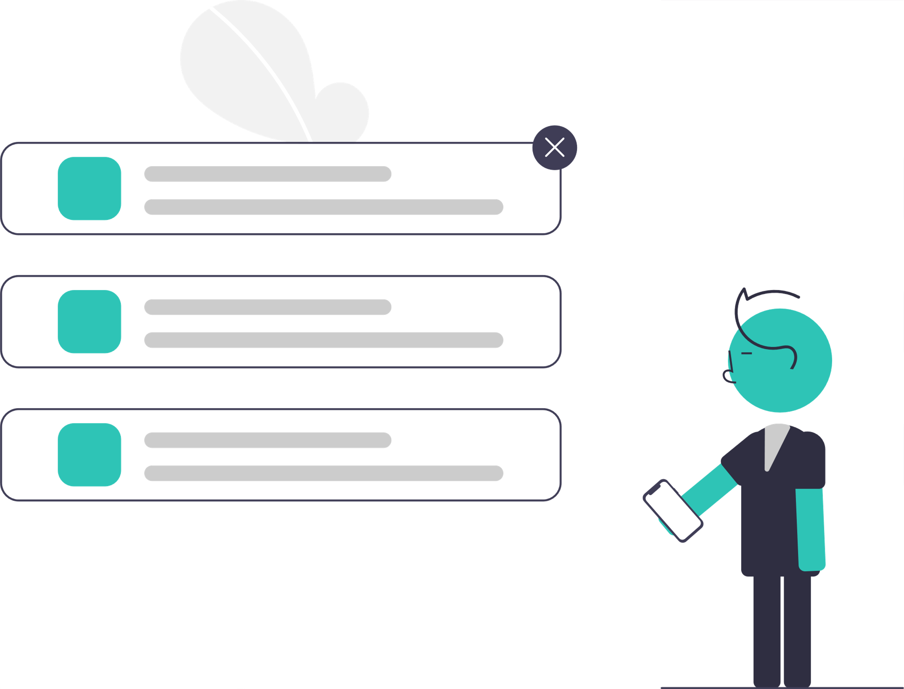


Add to Cart
i

Slide 9
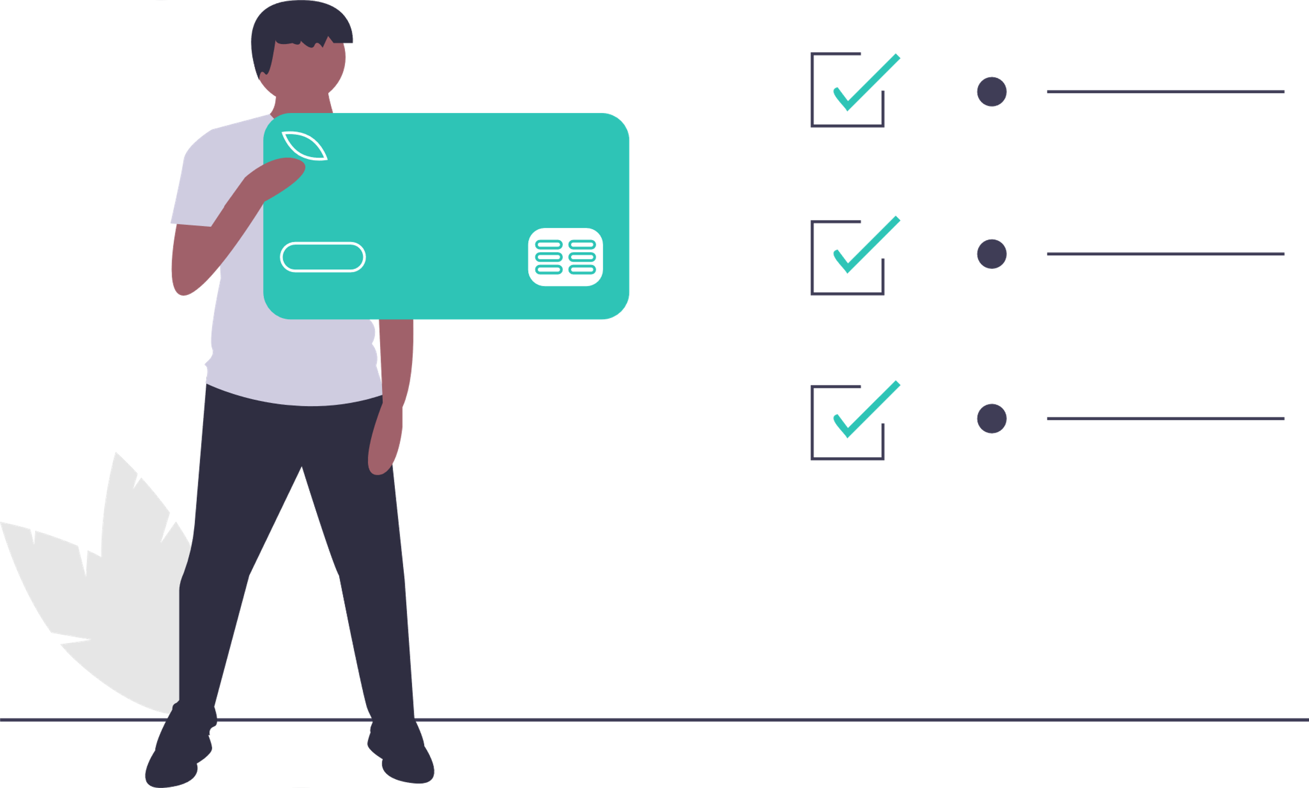
Online Payment
i
Credit Card
Debit Card
UPI
Paytm

Slide 10
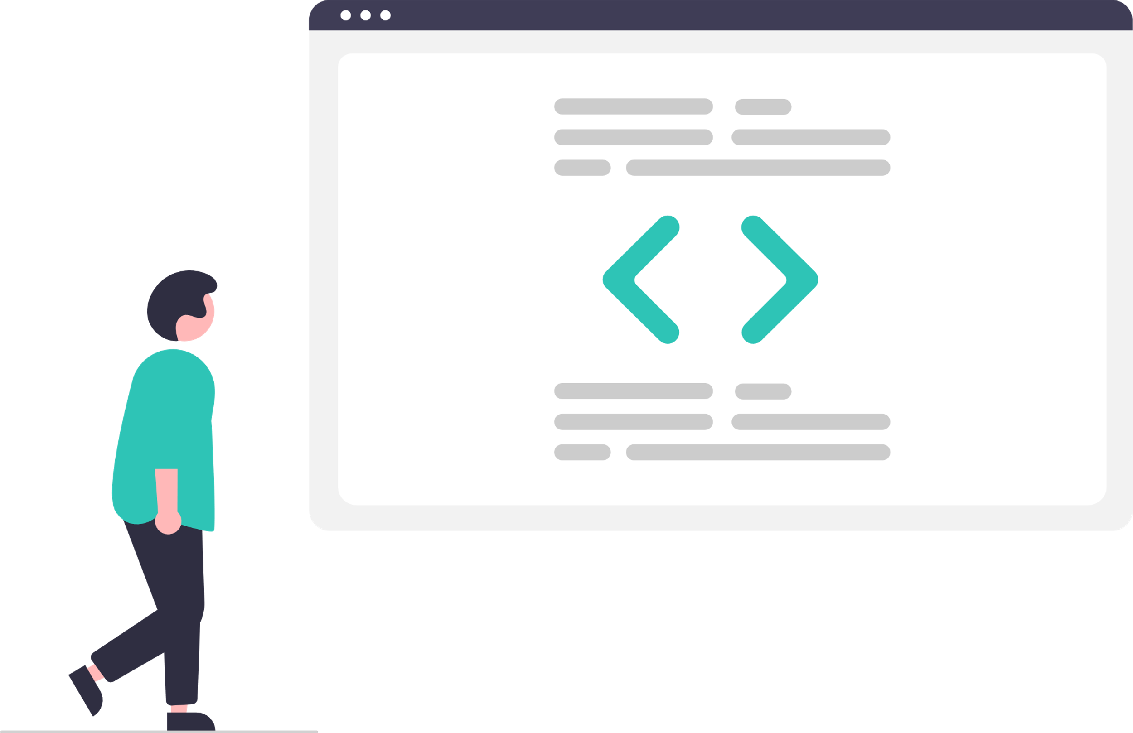
Technologies
i
Website: MERN

Slide 11
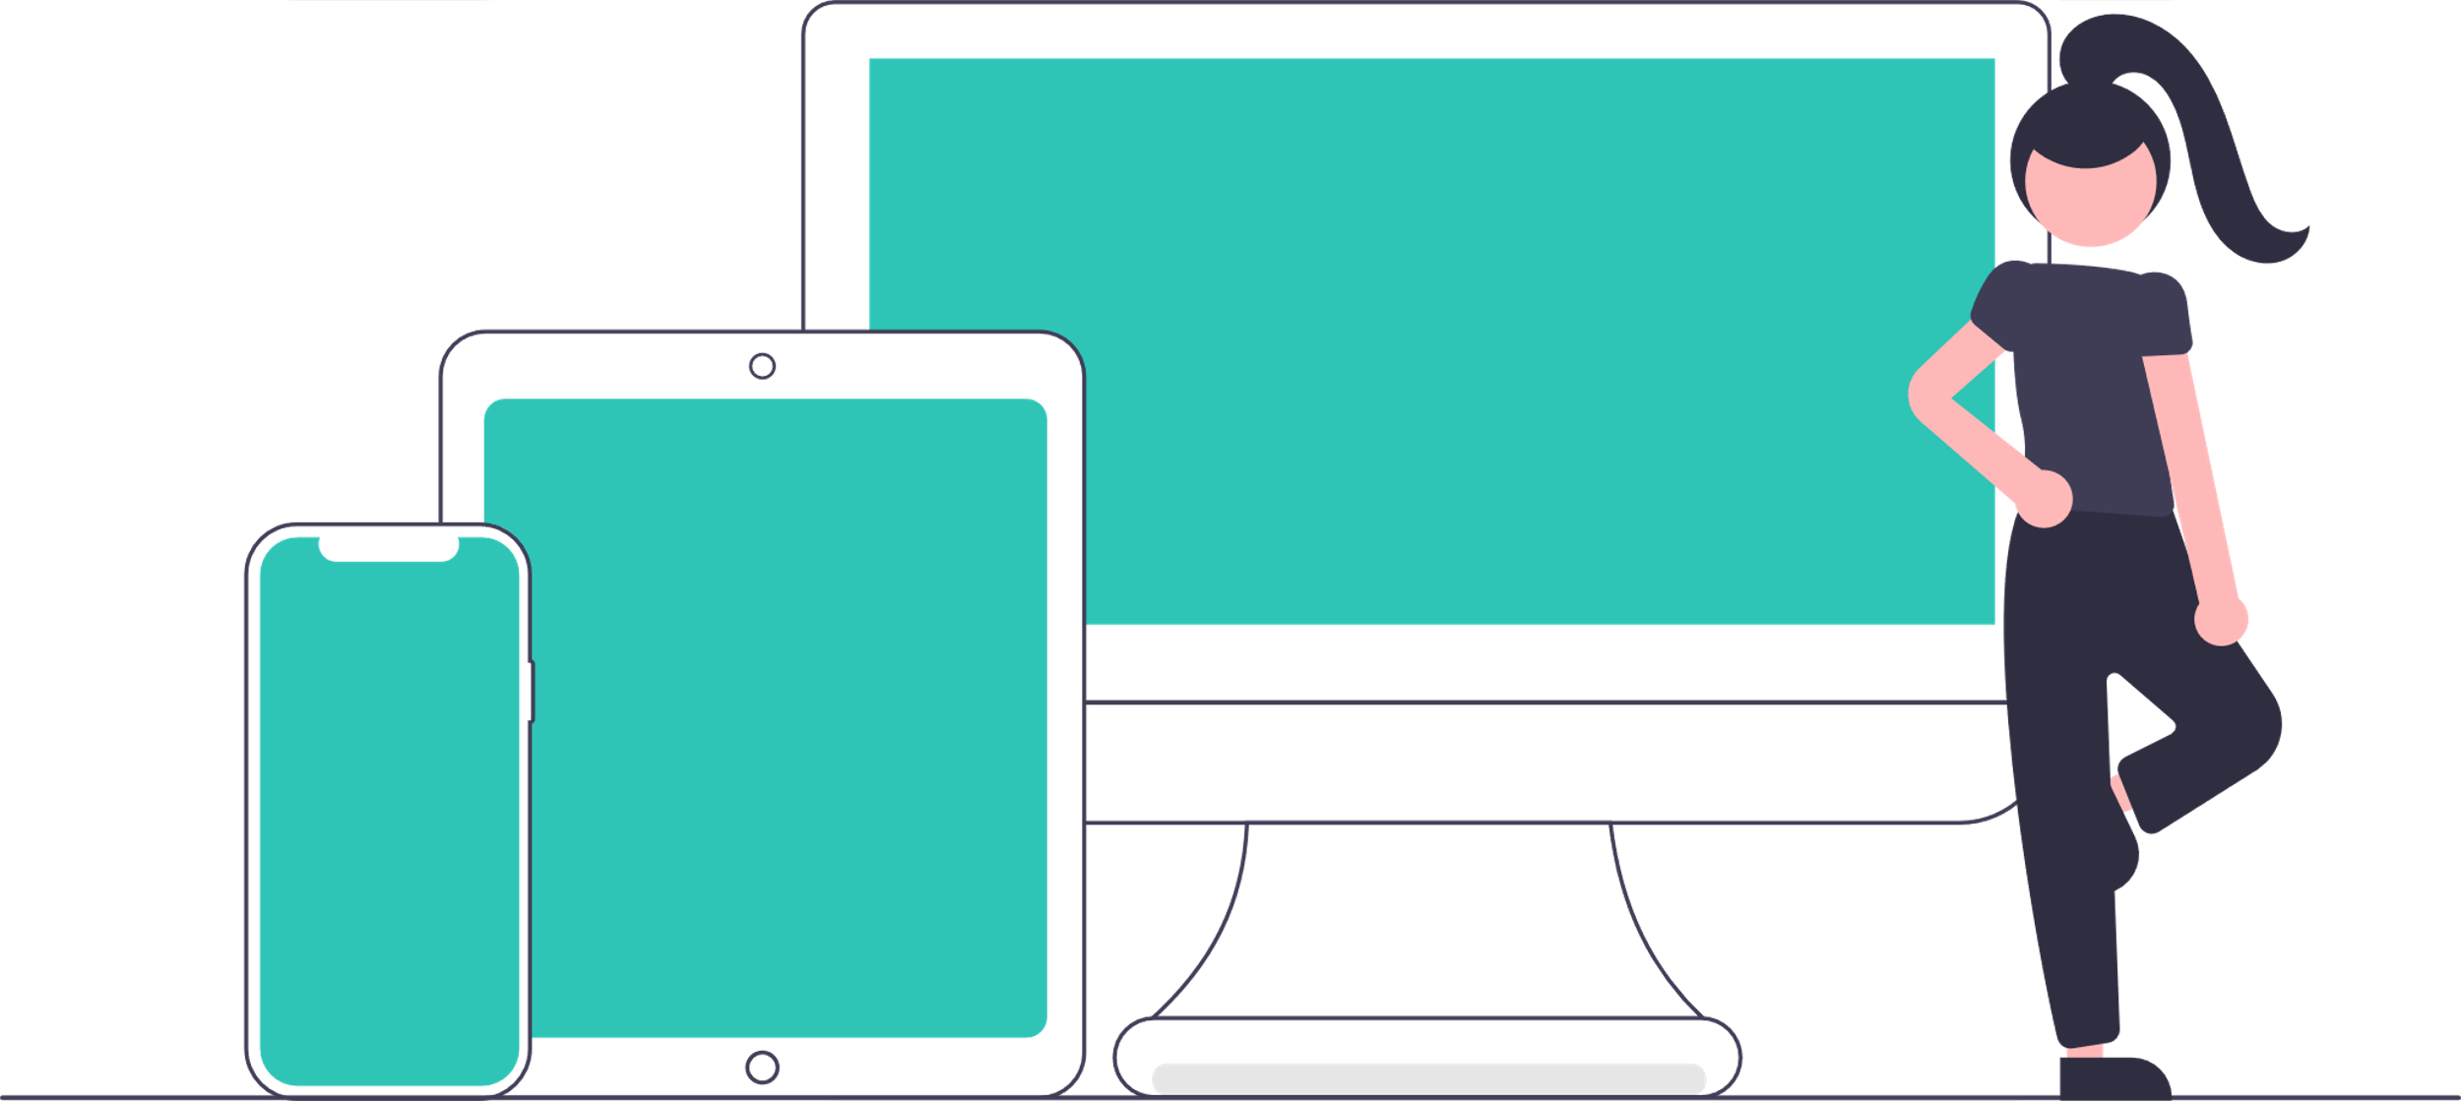
Availability: Play Store and Website
i

Slide 12
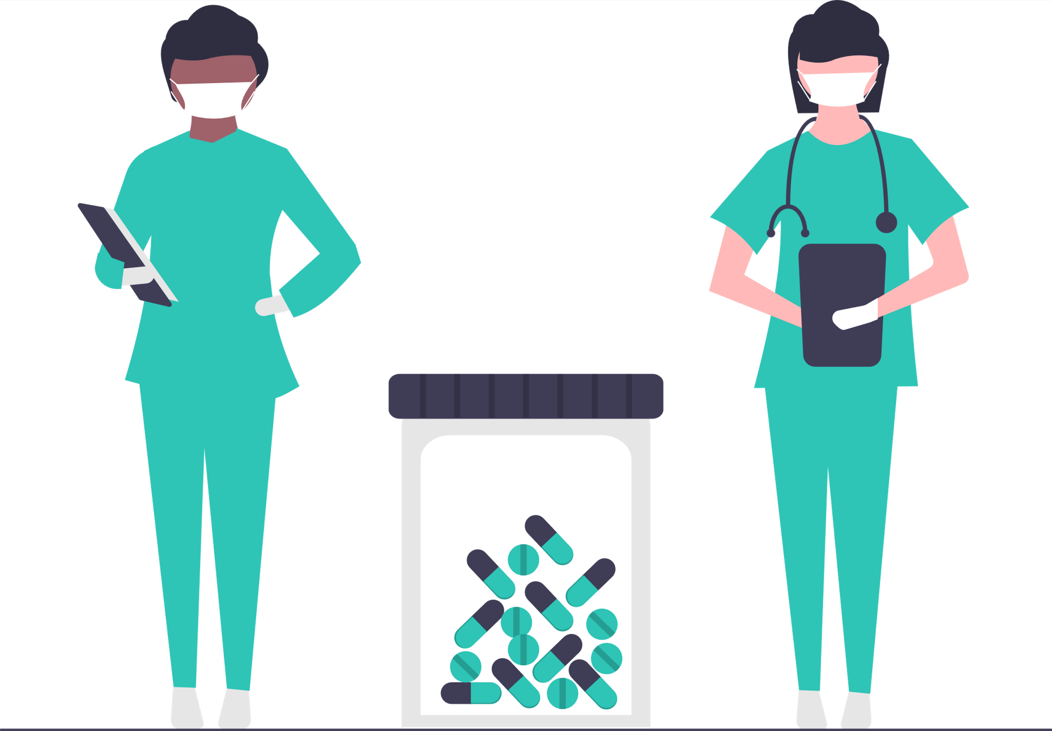
Stay Home Stay Safe

Slide 13
THANKS
FOR LISTENING WITH PATIENCE

